Slide 1
Fraud Prevention
Jay Haapala,
Associate State Director
AARP Minnesota
651-726-5654
jhaapala@aarp.org
Notes:
Hello my name is_____________. I am an AARP volunteer and I will be your facilitator today.
Thank you for coming. I am excited and looking forward to our discussion today. My job as your facilitator today is to present valuable information to you that will help you recognize and avoid fraud. However, as an AARP volunteer, I have had training on fraud and I do have some great material, but I am not an expert. I am going to be attentive to moving the conversation along to ensure we are respectful of your schedule and end on time.
Scammers steal billions of dollars from unsuspecting consumers every year. The impact on victims and their families can be financially and emotionally devastating, especially for older Americans. AARP created the Fraud Watch Network to empower consumers to spot and avoid scams, and to provide support and guidance to victims and their families when fraud happens. In addition to attending sessions like this today, you can find a wealth of resources at aarp.org/fraudwatchnetwork.
Some of you might be asking “Why is AARP engaged in this?” Well you might know that AARP began 60 years ago when its founder, retired school principal, Dr. Ethel Percy Andrus, discovered one of her former teachers living in a chicken coop. She was appalled that a woman who’d worked her whole life couldn’t even afford a place to live. She founded AARP to protect the financial security of older Americans. Fighting identity theft and fraud is part of that core mission.
So let’s get started……

Slide 2
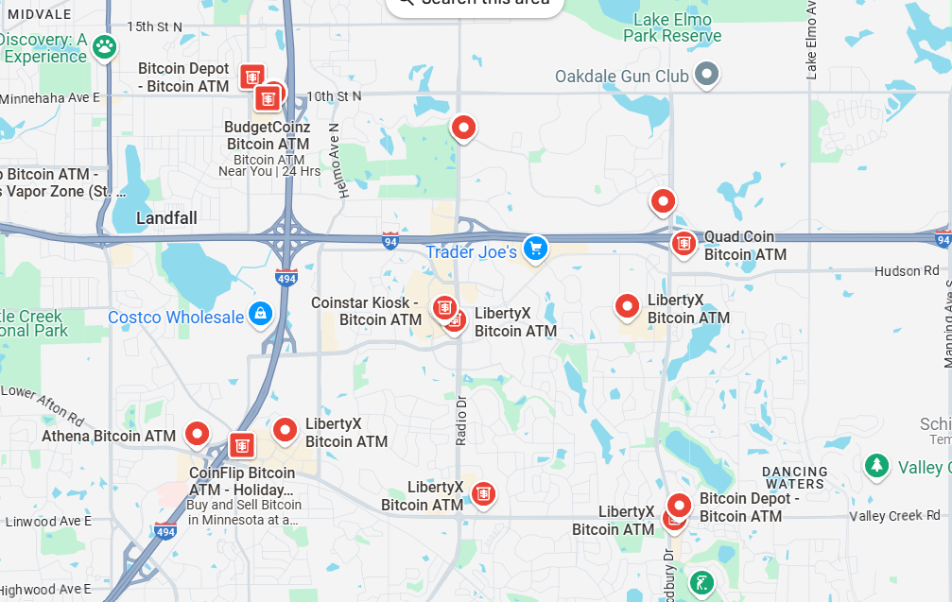
Cryptocurrency ATMs
Notes:
Anonymous payments contributing to the big increases.

Slide 3
Cryptocurrency ATMs Regulated
A New Minnesota law:
Provides a refund of the total transaction amount if reported with 14 days.
A daily transaction limit of $2,000
Requires operators to post warning signs
Notes:
Speaker Notes​
Criminals are adept at exploiting new technologies to scam consumers. AARP advocated for consumer protections to regulate virtual currency kiosks, also known as cryptocurrency ATMs. Crypto ATMs look and operate like bank ATMs and are found in grocery stores, convenience stores, gas stations, restaurants, and other spots across the state.
The bill protects new customers (i.e. register with the crypto atm) who are victims of fraud by:
providing a refund of the total transaction amount that occurred during the 72-hour new customer time period as long as they report the fraud within 14 days. The person must contact the virtual currency kiosk operator and a government or law enforcement agency to inform them of the fraudulent nature of the transaction.
Sets a daily virtual currency transaction limit of $2,000 for new customers
Requires operators to post warning signs that scammers may use virtual transactions to defraud consumers.
The kiosk operator is responsible for providing the refund.

Slide 4
Minnesota Fraud Victim Restitution Fund
An advocacy effort:
Many fraud victims struggle to pay their bills and daily expenses.
The Minnesota Attorney General would establish a fund from fines paid by businesses
The program could encourage more people to report cases and more criminal investigations
Notes:
Speaker Notes​
Criminals are adept at exploiting new technologies to scam consumers. AARP advocated for consumer protections to regulate virtual currency kiosks, also known as cryptocurrency ATMs. Crypto ATMs look and operate like bank ATMs and are found in grocery stores, convenience stores, gas stations, restaurants, and other spots across the state.
The bill protects new customers (i.e. register with the crypto atm) who are victims of fraud by:
providing a refund of the total transaction amount that occurred during the 72-hour new customer time period as long as they report the fraud within 14 days. The person must contact the virtual currency kiosk operator and a government or law enforcement agency to inform them of the fraudulent nature of the transaction.
Sets a daily virtual currency transaction limit of $2,000 for new customers
Requires operators to post warning signs that scammers may use virtual transactions to defraud consumers.
The kiosk operator is responsible for providing the refund.

Slide 5
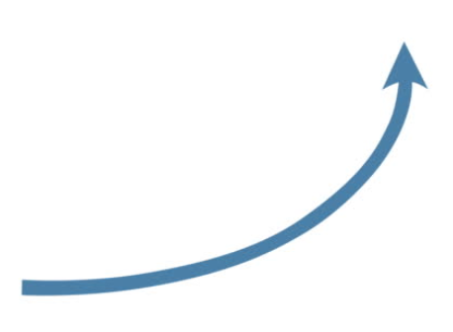
Fraud trends
2024: 2.6M victims, $12.5B stolen
2023: 2.6M victims, $10.0B stolen
2021: 2.9M victims, $6.1B stolen
2019: 1.9M victims, $2.4B stolen
2008: 1.3M victims, $1.7B stolen
Notes:
FTC Consumer Sentinel Data
Same reports show 2x the reports from people age 20-39 compared to people age 70+ in 2022

Slide 6
deepfake.civai.org
Notes:
The financial loss resulting from fraud is profound, particularly when victims are older adults at a time in their lives when they are least able to recover financially.
During the 2024 legislative session, AARP supported the Minnesota Attorney General's bill to create a state-level Restitution Fund for victims of scams and fraud. Unfortunately, given the short legislative session and time constraints, lawmakers did not move the bill this year. AARP will pursue this bill in future legislative session, and we need your help!
If you have been scammed or defrauded, please consider sharing you story with AARP MN. We are advocating for a fraud restitution fund, and personal stories helps to illustrate the need for this type of consumer protection. You can scan the QR code or use the link, aarp.org/mnstories. There is a short form to complete and then an AARP staff person will follow-up with you.

Slide 7
Focus on Consumer Protections
Monitor Accounts
Check Credit Reports
Stay Within the Banking System

Slide 8
Fraud Prevention
www.aarp.org/fraudwatchnetwork
877-908-3360
Jay Haapala, Associate State Director
AARP Minnesota
651-726-5654
jhaapala@aarp.org
Notes:
Hello my name is_____________. I am an AARP volunteer and I will be your facilitator today.
Thank you for coming. I am excited and looking forward to our discussion today. My job as your facilitator today is to present valuable information to you that will help you recognize and avoid fraud. However, as an AARP volunteer, I have had training on fraud and I do have some great material, but I am not an expert. I am going to be attentive to moving the conversation along to ensure we are respectful of your schedule and end on time.
Scammers steal billions of dollars from unsuspecting consumers every year. The impact on victims and their families can be financially and emotionally devastating, especially for older Americans. AARP created the Fraud Watch Network to empower consumers to spot and avoid scams, and to provide support and guidance to victims and their families when fraud happens. In addition to attending sessions like this today, you can find a wealth of resources at aarp.org/fraudwatchnetwork.
Some of you might be asking “Why is AARP engaged in this?” Well you might know that AARP began 60 years ago when its founder, retired school principal, Dr. Ethel Percy Andrus, discovered one of her former teachers living in a chicken coop. She was appalled that a woman who’d worked her whole life couldn’t even afford a place to live. She founded AARP to protect the financial security of older Americans. Fighting identity theft and fraud is part of that core mission.
So let’s get started……

